Slide 1
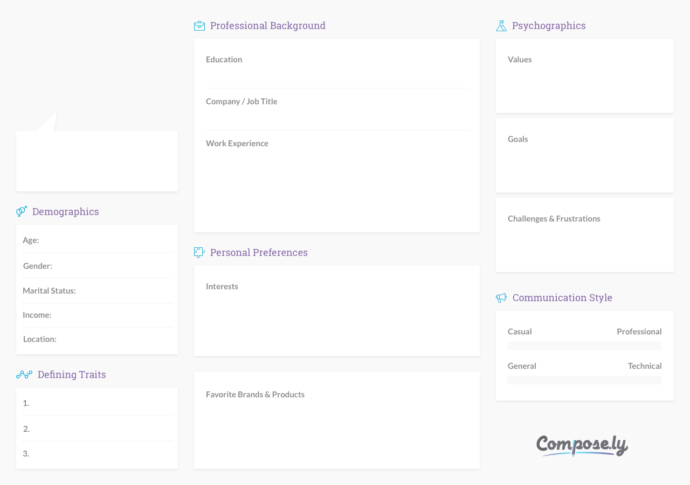
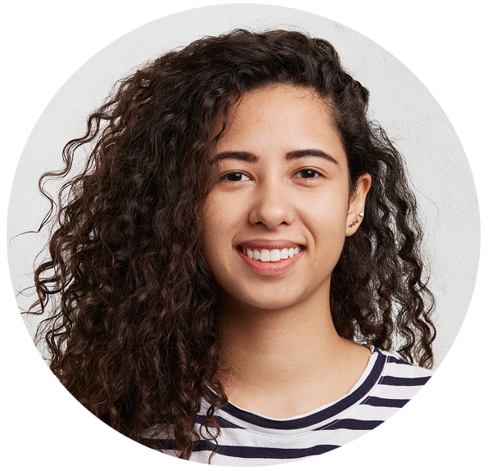

Lilian Fernando
M.S. in Nutrition, Texas Woman’s University
Efficiency, responsiveness and clear communication, work-life balance
Nourish Juice Bar / Founder & Owner
I’m juggling so many aspects of my business – there must be a shortcut or way of outsourcing some of my needs.
Grow Nourish Juice Bar’s online presence through blogging and social media outreach
After graduating with a master’s in nutrition, Lilian began her career in community health by promoting healthy eating habits in schools and nursing homes. She then became a Nutritional Health Coach at her local YMCA for six years, departing only recently to pursue her dream of opening a juice bar.
31
Lack of time to write, difficulties finding competent freelancers
Female
Single
Cycling, kayaking in Lake Travis, comedy shows, fine dining with friends, volunteering at the local animal shelter
$67,000/year
Austin, Texas
Self-motivated
Adidas, H-E-B, Garmin, Keurig, Magic Bullet Blender, Orangetheory Fitness, SoulCycle
Creative
Enthusiastic

Slide 2
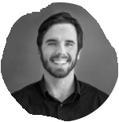
Matt MacPhee
MSC I/O Pysch SMU
Work Life Balance
Manager Business Design SMUEC
‘No Comment’
CONSULTING
TEACHING
ETC
Go climbing in Alaska
Write and record a heavy metal album
Career planning
Do I start a business?
Getting older means athletic is harder
Priotizie retirement (work more?) prioritize fun/travel/etc
37
Male
Married
Rock climbing, music, guitar, reading, general outdoor stuff, exercise, eating jumbo sized bags of chips, Call of Duty, playing with my dogs, teaching myself how to do house renos
$50,000
Halifax, Nova Scotia
Stubborn
Arcyteryx, Toyota Tacoma, Garmin, ESP Guitars, Starbucks, Blundstones
Like to learn
Dedicated to my goals

